Slide 1

FINAL PROJECT
//01
US Police Violence and Racial Bias Prediction
Amanda Thomson
Niger Rowser
Shivam Mittal
Tamara Grigoryeva
GWU Data Analytics Bootcamp
2021

Slide 2
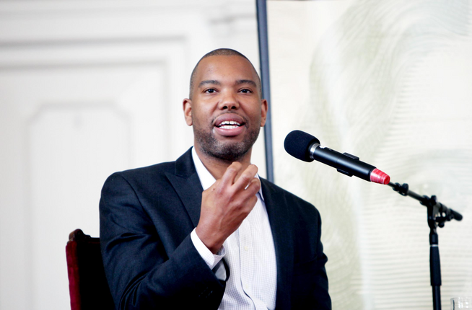

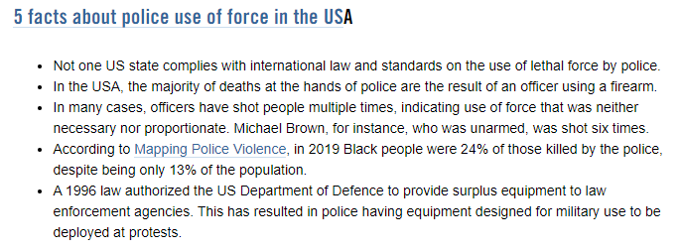
//02
The police reflect America in all of its will and fear, and whatever we might make of this country's criminal justice policy, it cannot be said that it was imposed by a repressive minority.” ― Ta-Nehisi Coates, Between the World and Me
Why
Analyze
Police
Violence

Slide 3




//03
Tamara
Grigoryeva
NIgel
Rowsel
Amanda Thomson
Shivam
Mittal
The team

Slide 4

The Data Sources
OPEN SOURCE QUALITATIVE DATA (ARTICLES, INTERVIEWS)
KAGGLE DATASETS ON US POLICE VIOLENCE
MAPPING POLICE VIOLENCE PROJECT
POLICE BUDGETS DATASET
//04

Slide 5
The Questions
MAIN QUESTION: IS THERE RACIAL BIAS
IN POLICE VIOLENCE IN THE US?
SUPPORTING QUESTIONS:
WHAT ARE THE TOP STATES/ COUNTIES FOR POLICE VIOLENCE IN 2013-2020?
WHAT IS THE DEATHS BREAKDOWN BY RACE VS. COUNTRY POPULATION BY RACE?
IS THERE A CORRELATION BETWEEN THR AGE OF TH VICTIM AND WHETHER THEY FLED?
WHAT ARE THE POLICE DEPARTMENTS' BUDGETS?
CAN POLICE VIOLENCE IN THE US BE PREDICTED BASED ON FACTORS SUCH AS RACE?
//05

Slide 6

DATA EXPLORATION/ SELECTION
MAPPING POLICE
VIOLENCE PROJECT DATASET
WASHINGTON POST DATASETS
KAGGLE DATASETS
budgets dataset
//06

Slide 7

The Exploratory Analysis (ML)
//07
DATA CLEANING
dropping & renaming columns
dropping null valies or replacing them w NaN
changing data type from object to int
transforming text values into numerical values (get_dummies)
DATA EXPLORATION
ML MODELS
creating features & targets (race)
train, test & split the model
random forest
decision tree
logistic regression
picked model with highest accuracy score

Slide 8

The
Exploratory Analysis
(Tableau,
Python)
//08
HEAT MAP
filtering data by top 10,20,30,40,50 states (+county, city)
additional filter by year, month
CORRELATION BETWEEN AGE & FLEEING
DOUGHNUT CHART
victim count & age
filtered by fleeing by foot/ in a car & not fleeing
BUDGET
filtered by year
for every department
killings by race vs. population by race breakdown

Slide 9
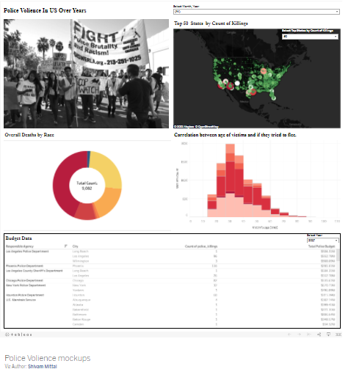


TM
AstraStrong
Project Outline
//09

Slide 10

//10
FURTHER STEPS, IF WE HAVE MORE TIME
Make maps of cities with exceptionally high killings/ Map by individual police officer
Compare the data with countries where police is unarmed
Interview social scietists/ criminal justice experts

Slide 11
Contact Information
grigoryeva.tamara@gmail.com
acfthomson@gmail.com
nigelrowser@gmail.com
mittalshivambi@gmail.com
//11

